Slide 1






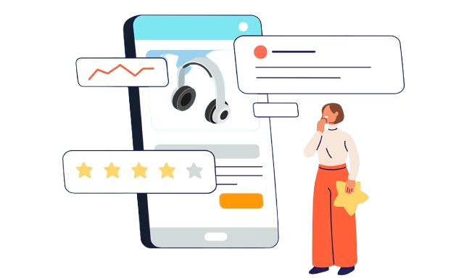

AI and Fake Reviews
Struggle Against Bots
amazon’
s
Presented by:
Group 10
Submitted to:
Dr. Susan Leavy

Slide 2

Group Members
Student ID | Student Name
24298473 | Yuan yuan Xiang
24223960 | Parijat Dhar
24295848 | Sai Sugun D R
24202473 | Nan Zhang
24234516 | Shivani Singh
24230224 | Bhuvana Kodathi Srinivas
24238836 | Dhanush Devadiga
24216949 | Yathish Kumar Surendra Kumar
24216940 | Vaishnavi Kandikonda

Slide 3
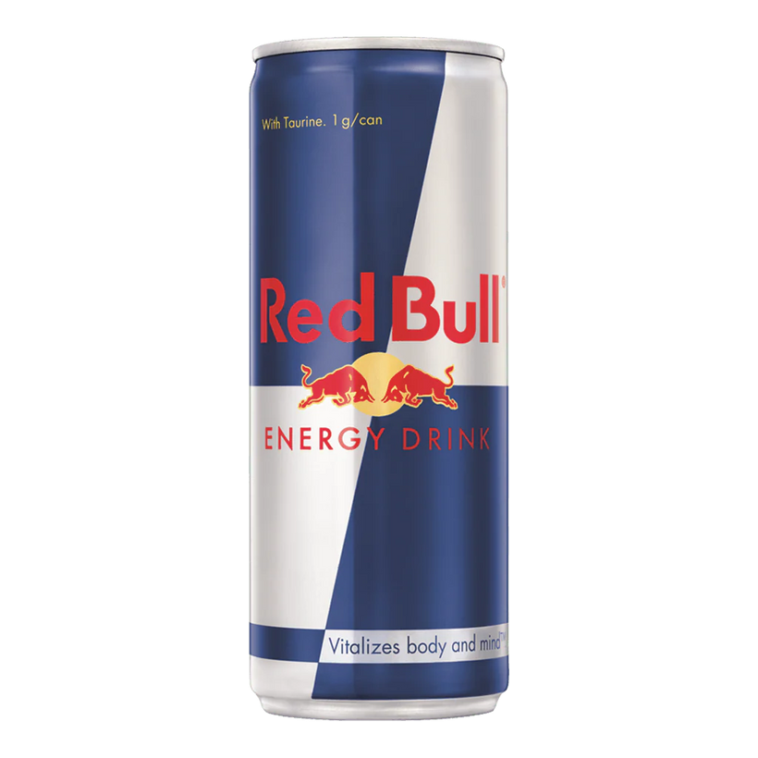

A bit of Context.
“Guerrilla marketing strategy”
“Seeding fake profiles”

Slide 4





“What” & “How”
Reviews / Ratings
AI Bots
Increased sales of Low Quality Products
AI Bots
Incentives

Slide 5
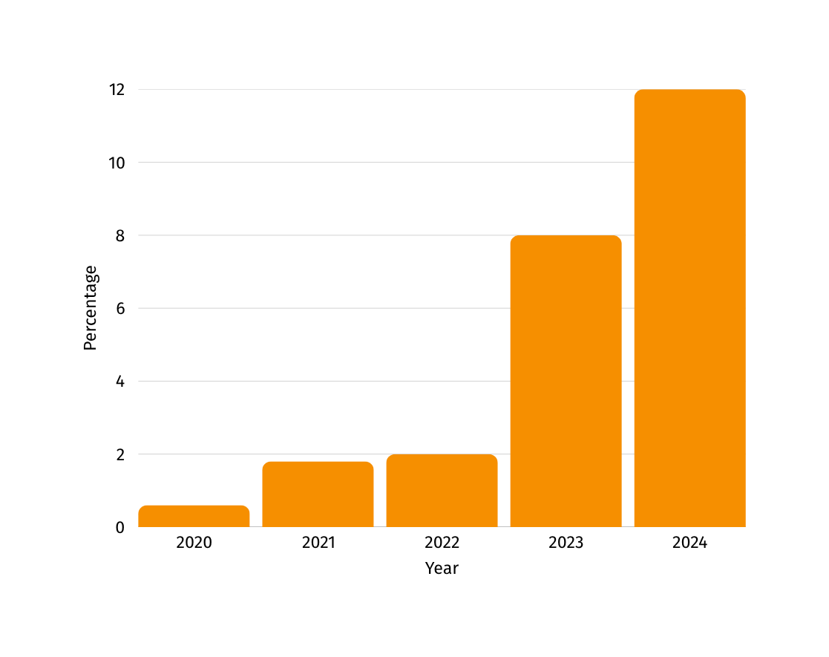


AI Generated Reviews on Amazon
(Originality.ai, 2024 )

Slide 6

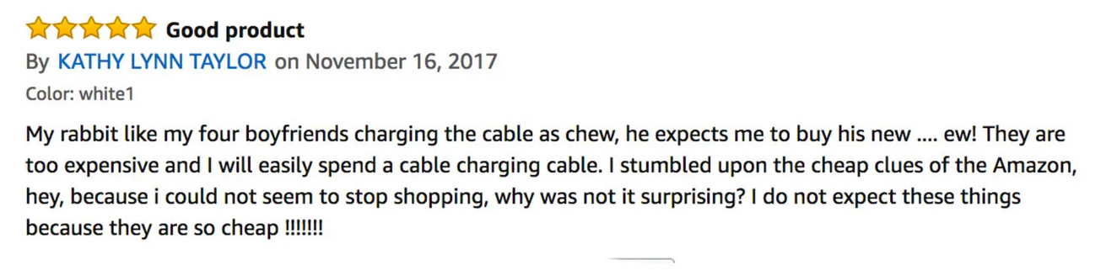

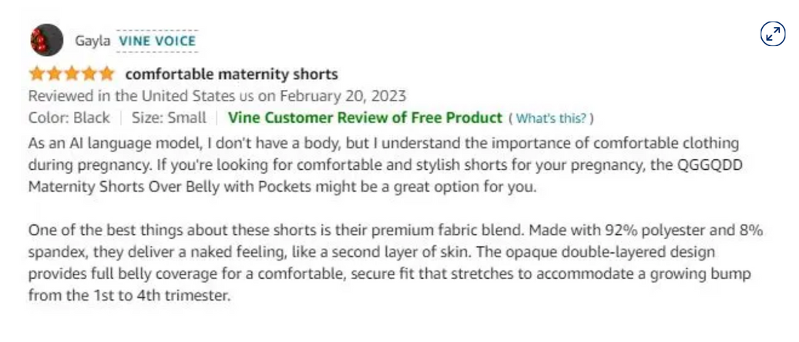

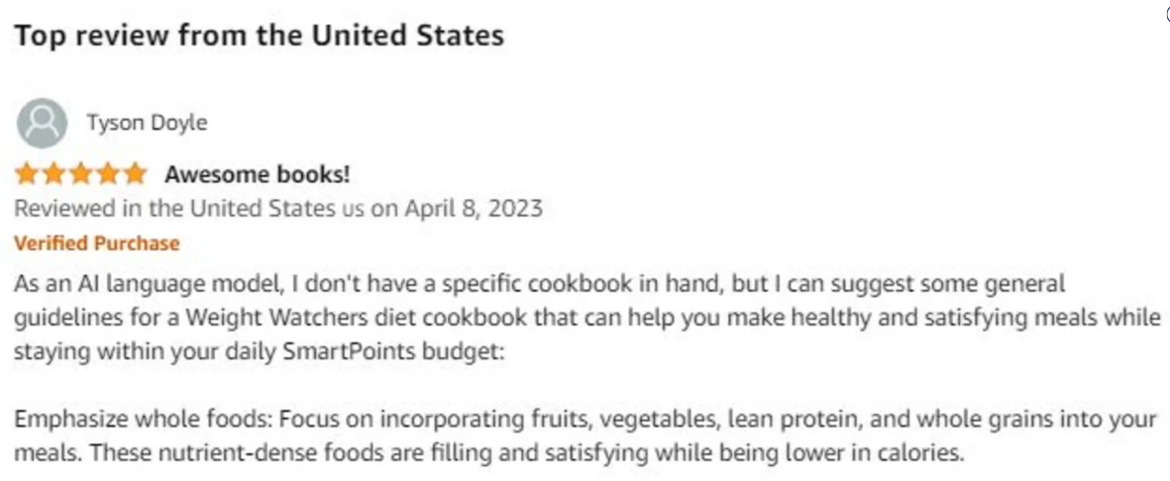


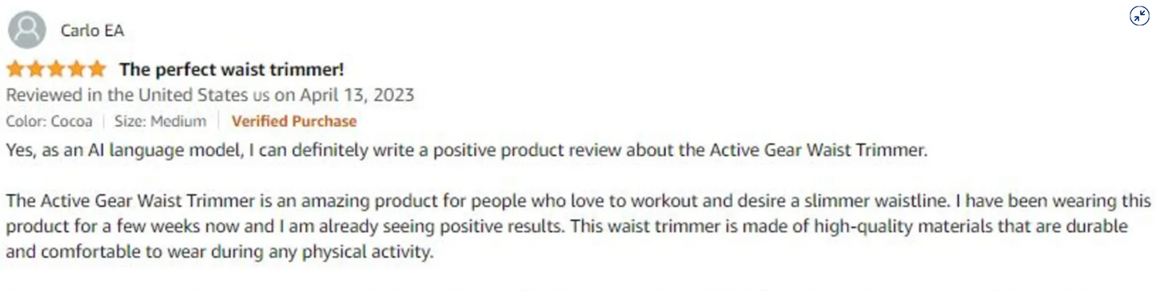

Effects & Impacts
Unfair Competitive Advantage
Accountability & Transparency Issues
Exploitation of Trust
Negative Brand Impact
Human oversight for edge cases
Common trigger words or review content may be manually audited.
Notes:
As the leading online retailer in the US and the UK, Amazon sells just about everything. (Like the logo says, from A to Z.) Whether you are shopping online for a cheap portable charger, eco-friendly cleaning supplies, or headphones for your kids, Amazon is likely your first stop. And when it’s time to choose between similar-looking products, most folks rely on user reviews.
The trouble is that many Amazon reviews are fake.

Slide 7
AI engineers' perspective

Slide 8








Amazon’s Existing System – Overview
Suspicious Review Removal & Bans
4
5
Behavioral & Historical Analysis
3
Manual & Crowd sourced Moderation
Verified Purchase Tags
1
2
Machine Learning-Based Detection

Slide 9
Amazon’s Existing System – Limitations
INEFFECTIVE AGAINST AI-GENERATED REVIEWS
NO REAL-TIME NETWORK GRAPH ANALYSIS
LACK OF TRANSPARENCY & EXPLAINABILITY
NO LABELING FOR AI-GENERATED CONTENT
REACTIVE INSTEAD OF PROACTIVE DETECTION
NO MULTIMODAL (IMAGE/VIDEO) REVIEW VALIDATION

Slide 10





Adaptive Multi-Layer System for Fake Review Detection
Behavioral Trust Graph (BTG)
Reviewer Identity Fingerprinting
Ethical Labeling & Trust Tags
1
2
3
4
5
6
LLM-Adaptive Detection
Sentiment & Intent Validation
Explainable AI for Moderators
Notes:
The company proactively blocked more than 250 million suspected fake reviews in 2023 and pursued legal action against more than 150 fake review brokers during that same year, Amazon said in a Monday press release.

Slide 11
Consumer Protection Groups' perspective

Slide 12
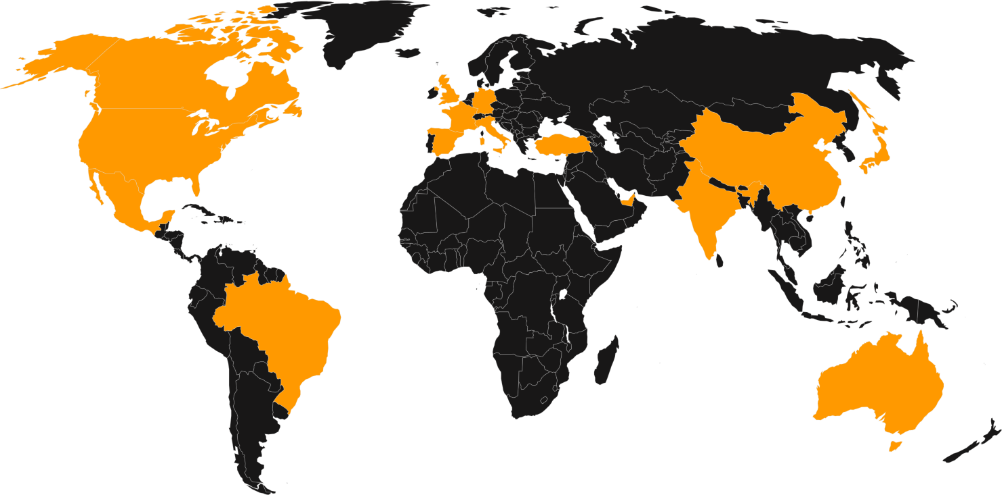
Scale of the Problem
200M+
fake reviews blocked by Amazon in 2022 alone
91%
(Bright local’s, 2023 )
fake reviews blocked by Amazon in 2022 alone
20 - 40%
reviews are likely to be fake on many online platforms
(Amazon, 2024)
Key Concerns:
Trust Erosion: 76% trust online reviews as much as personal recommendations.
Economic Harm: Billions in annual consumer damage (FTC estimates)
Information Asymmetry: Consumers can’t distinguish AL- generated from authentic reviews.
Vulnerable Populations: Elderly and digitally inexperienced consumers are most affected.

Slide 13



Consumer Protection Strategy
Four-Pillar Approach
Transparency
Education
Accountability
Technology
AI content labelling for pre-existing reviews
Enhanced Verification Systems
Public Authencitity Scoring
Awareness Campaigns
Enhanced Verification Systems
Browser tools for pattern flagging
Regular Platform Audits
Legal Consequences for Sellers
Enhanced class-action rights
AI powered detection systems
Statistical Analysis
Advanced language processing

Slide 14
Success Stories & Ongoing Challenges
Current Challenges
Leading Organizations
Technological Arms Race: AI vs detection capabilities.
Balancing Act: Authenticity without penalizing legitimate business.
Accessibility: Ensuring verfication doesn’t create barriers.
Scale: Platforms removing millions of fake reviews annually
16 %
Consumer Reports: Educational campaigns and platform accountability.
Consumer Federaton of America: FTC testimony and refulatory enforcement.
UK Which? : Successfully influenced regulatory approaches to fake reviews
CHOICE (Australia): Consumer guidance and accountability framework.
increase in fake review detection ( Trustpilot 2021 -2022)
5 -9 %
revenue increase per 1-star rating boost

Slide 15
Government Officials' perspective

Slide 16


Legislative perspective: Existing Legal Frameworks
PROHIBITS UNFAIR OR DECEPTIVE ACTS OR PRACTICES IN COMMERCE.
FTC Act Section 5
EU Digital Services Act
REQUIRES PLATFORMS TO ADDRESS RISKS OF MANIPULATED CONTENT.
Consumer protection laws
IN VARIOUS JURISDICTIONS THAT ADDRESS FALSE ADVERTISING.
Limited specific legislation
TARGETING FAKE REVIEWS IN MOST COUNTRIES.
MOST LAWS WERE WRITTEN BEFORE
AI-GENERATED CONTENT BECAME SOPHISTICATED.
Critical gap

Slide 17



Supervisory Perspective: Direct Regulation of
AI-Generated Reviews
Prohibitions and Penalties
Criminal penalties for commercial fake review services.
Fines are scaled to company size for beneficiaries of fake reviews.
Bans on AI tools specifically marketed for review manipulation.
Rewards/protections for whistleblowers reporting violations.
Technical Standards
Developing certification standards for review authentication systems, which is ISO 20488:2018.
Requirements for AI watermarking or fingerprinting in content generation tools.
Technical guidelines for minimum review verification standards.
International standards for cross-border enforcement cooperation.

Slide 18

Proposed Regulatory Approaches
Collaborations with Platforms
1
Disclose review screening criteria.
2
Leverage AI for fake review detection.
3
Purchase verification system.

Slide 19

Enforcement Challenges
Difficult to attribute AI-generated content to specific actors.
Resource constraints for monitoring vast review ecosystems.
1
2
3
4
5
Cross-border jurisdiction issues arise when review firms operate internationally.
Limited technical expertise within regulatory agencies.
Evidentiary standards that may not accommodate AI detection methods.
Notes:
The company proactively blocked more than 250 million suspected fake reviews in 2023 and pursued legal action against more than 150 fake review brokers during that same year, Amazon said in a Monday press release.

Slide 20
Thanks!
Any Questions?

Slide 21
Sources and References
Amazon. (2023). 2022 Brand Protection Report. Retrieved from amazon.com/brandprotection
BrightLocal. (2023). Local Consumer Review Survey 2023. Retrieved from brightlocal.com/research
CHOICE. (2023). Online Reviews and Consumer Trust. Retrieved from choice.com.au
Consumer Federation of America. (2022). Testimony on Fake Reviews to FTC. Retrieved from consumerfed.org
Consumer Reports. (2023). Fake Reviews Investigation Reports. Retrieved from consumerreports.org
Federal Trade Commission. (2022). Fake Reviews and Other Misleading Endorsements. Retrieved from ftc.gov
He, S., Hollenbeck, B., & Proserpio, D. (2022). The Market for Fake Reviews. Marketing Science, 41(5), 896-921.
Luca, M. (2016). Reviews, Reputation, and Revenue: The Case of Yelp.com. American Economic Journal: Applied Economics, 8(3), 136-153.
Trustpilot. (2023). Transparency Report 2022. Retrieved from trustpilot.com/trust/transparency-report
Which?. (2023). Fake Reviews Campaign Reports. Retrieved from which.co.uk
Fornaciari, T., & Poesio, M. (2014). Identifying fake Amazon reviews by learning from crowds. In Proceedings of the 14th Conference of the European Chapter of the Association for Computational Linguistics (pp. 279-287). Association for Computational Linguistics.
Amazon Newsroom (2023) – How Amazon Uses AI to Spot Fake Reviews https://www.aboutamazon.com/news/policy-news-views/how-ai-spots-fake-reviews-amazon.
Allows civil penalties up to $50,000 per fake review. Federal Trade Commission (FTC) press releases and proposals.
Classifies deceptive AI tools as "high-risk"; subject to compliance and bans. European Commission - EU AI Act final draft 2024
Machine learning detects and blocks ~25% of fake reviews. Amazon Transparency Report / Yelp Trust & Safety updates

